Slide 1
Internet Privacy
Nick Feamster Computer Networking

Slide 2
Problem
Increasing number of Internet-connected IoT devices in consumer homes.
Devices ship with security & privacy flaws.
Cannot rely on manufacturers alone to secure software or devices

Slide 3

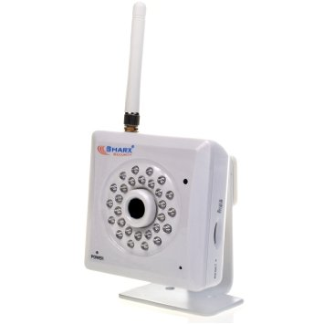
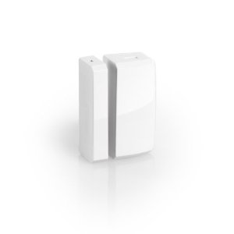
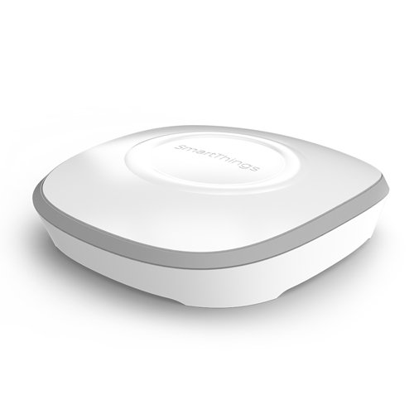

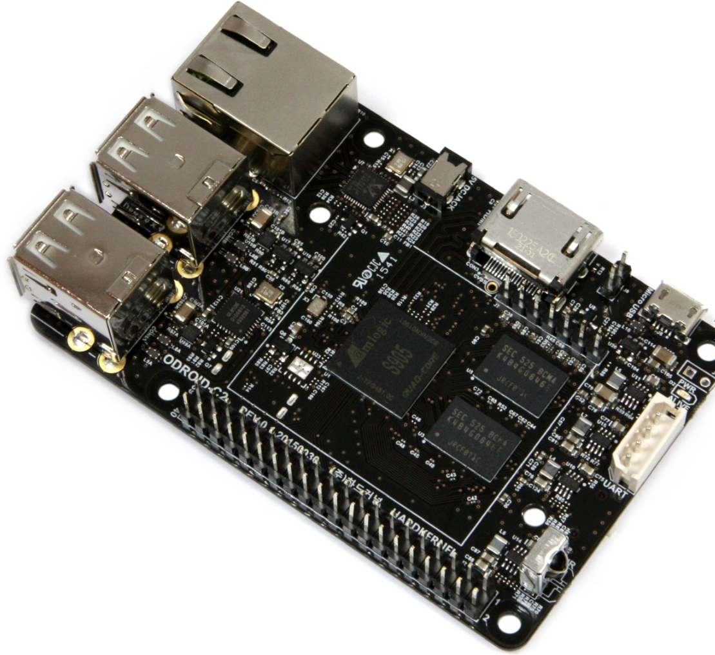
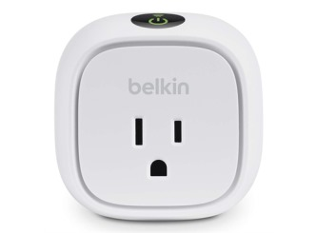
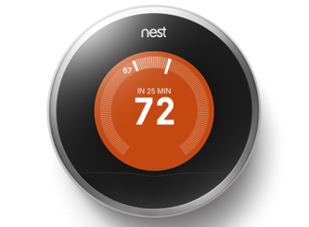
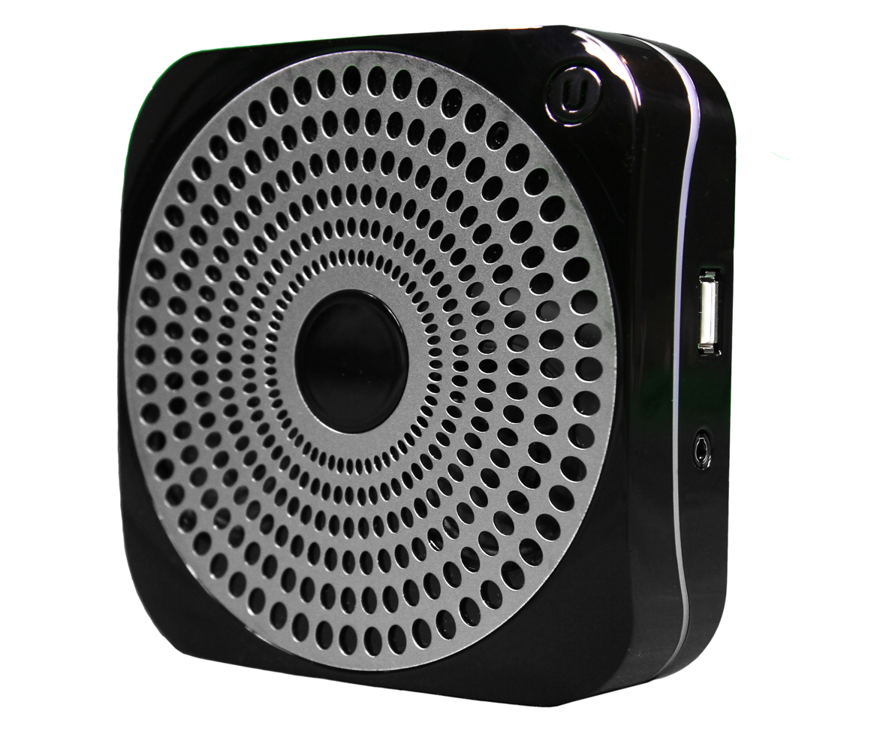
Approach 1: Controlled Lab Studies
PixStar Digital Photoframe
Sharx Security IP Camera
SmartSense Multi-sensor
Smartthings Hub
WiFi
Z-Wave
Gateway (Passive Monitor)
Belkin WeMo Switch
Ubi Smart Speaker
Nest Thermostat
Notes:
As before, we started with a simple question: What are these devices doing? Who are they talking to? (circa 2015)
We picked top few devices on amazon, tried to pick different manufacturers.
Thought this would be a lot harder than it turned out to be… (no encryption!)

Slide 4
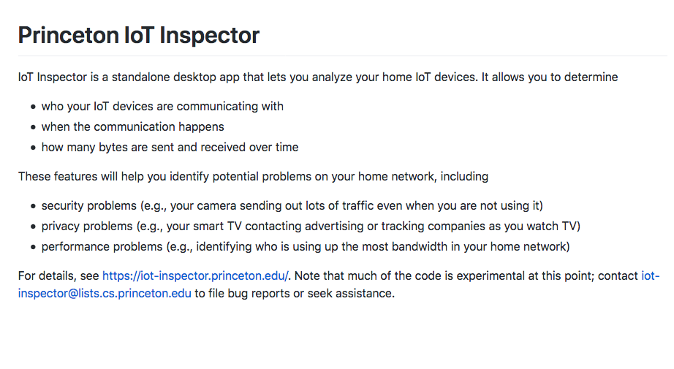
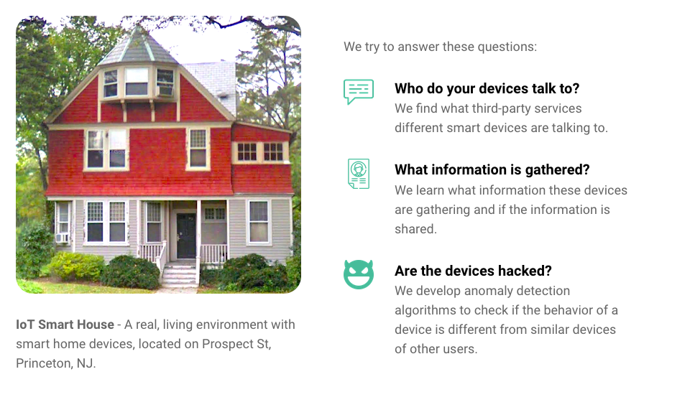
Notes:
We’ve continued to work on this over the past several years (Danny Huang).

Slide 5
Data Risks: Attackers Can Learn About Activities Inside the Home

Slide 6
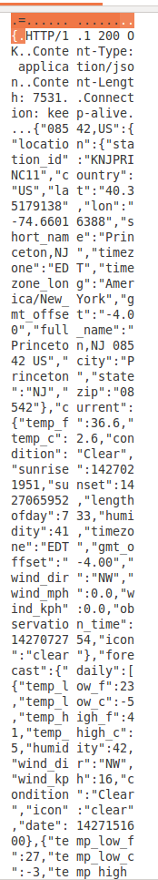
Nest Thermostat: Unencrypted Data…
All traffic to Nest is HTTPS on port 443 and 9543
Uses TLS v1.2 and TLS v1.0 for all traffic
We found some incoming weather updates containing location information of the home and weather station in the clear. Nest fixed this bug after our report.
Notes:
-----------
DNS query: time.nestlabs.com, frontdoor.nest.com, log-rts01-iad01.devices.nest.net. transport01-rts04-iad01.transport.home.nest.com

Slide 7
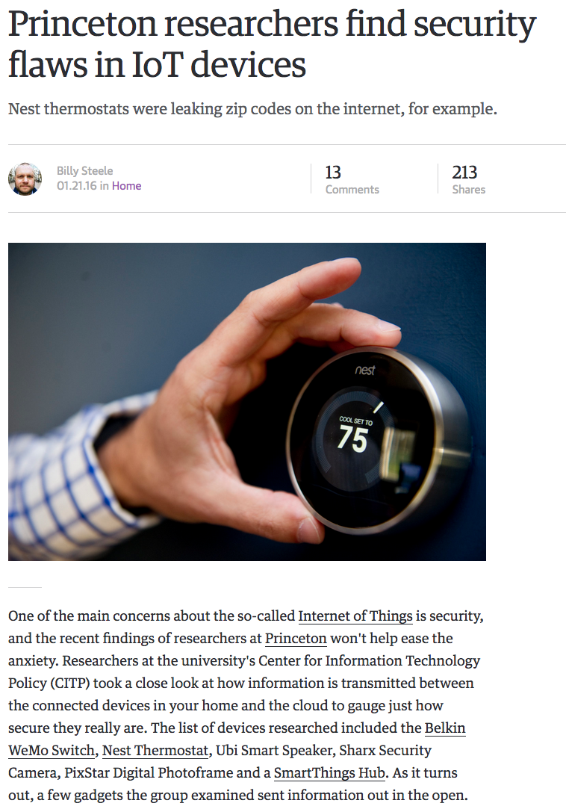


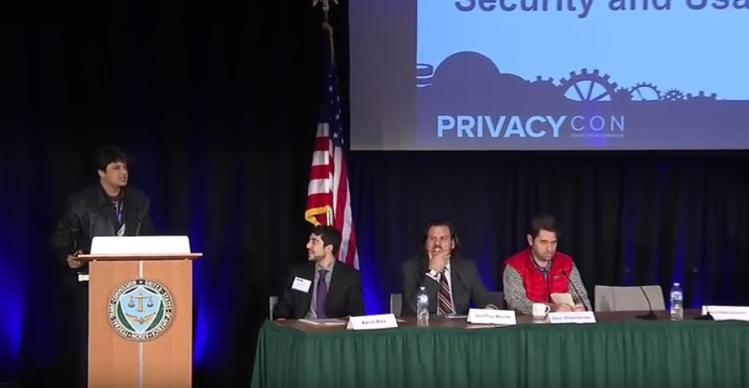
Notes:
Reported in the news, presented at the Federal Trade Commission…
Just encrypt, right?

Slide 8
Model
Passive network observer threat model approximating an ISP
Can view/record all WAN traffic to/from home gateway router
Cannot view LAN traffic between devices behind gateway router.
Cannot manipulate network traffic
Can obtain and analyze IoT devices to help identify devices in live traffic
Packet contents are encrypted
Metadata available
IP packet headers
Transport layer packet headers
DNS queries
Send/receive rates
Notes:
Took the perspective of an adversary:
Does a strategy exist to infer user behavior from encrypted IoT traffic
It’s important to be specific:
We defined a passive network attacker threat model that approximates an ISP: FCC rulings
Try to make our assumptions as conservative as possible
Raises the questions:
What are smart home IoT devices?
How are they connected to the Internet?
We define a “smart home device” as any single-purpose Internet-connected device intended for home use
or a hub-like device that connects and controls multiple single- purpose devices
We assume that the majority of these devices are located behind a home gateway router that acts as a firewall and a Network Address Translator (NAT)
This is a “best case” assumption. Note that the security cameras involved in the most recent DDoS attack had public IP addresses
cannot manipulate network traffic - we assume that an ISP or similar attacker will not want to perform active attacks on most users
Adversary can obtain and analyze IoT devices just as we have, and record traffic to observe DNS queries and train machine learning classifiers for use on live traffic
Encrypted packet contents because all 4 devices we tested used SSL/TLS.
We suspect that the percentage of IoT devices that do use encryption will continue to increase
By no means the only or best model: could have looked at malicious devices or wifi eavesdropper
This model an approximation of ISP following privacy best practices and a device following best practices

Slide 9

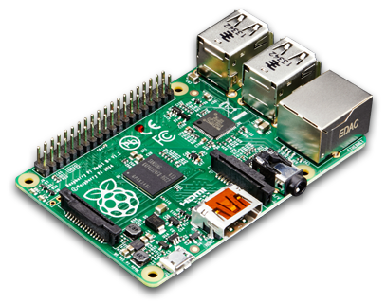

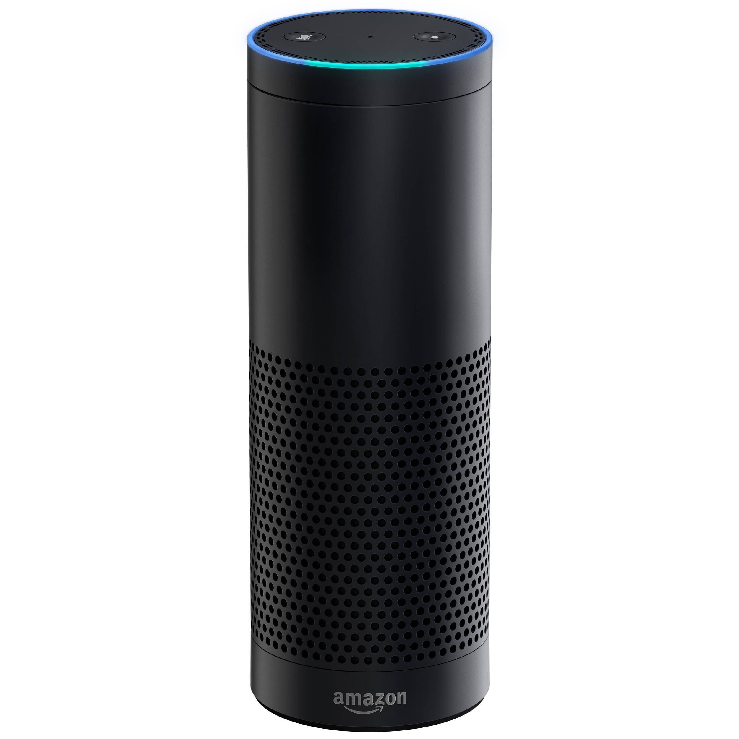
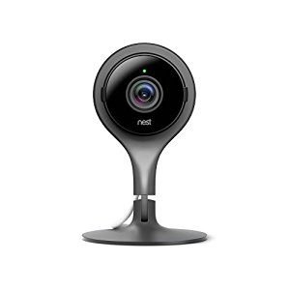
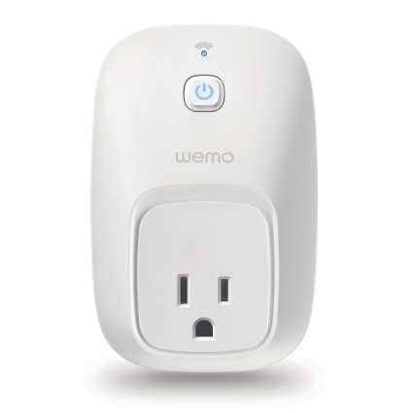
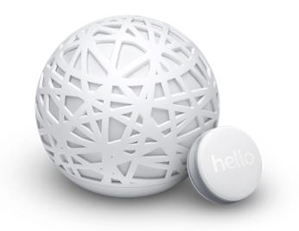
Smart Home Laboratory
WAN
WireShark
Notes:
we purchased 4 popular smart home IoT devices and set up a smart home laboratory to observe and record their network behavior.
These devices included a Nest Indoor security camera, a WeMo smart outlet, an Amazon Echo, and a Sense Sleep Monitor.
We configured a raspberry pi to act as a wifi access point, and we connected each of the devices to the wireless network
In this setup, the Raspberry Pi acts as a home gateway router and NAT, translating the local IP address of each device on it’s wifi network to the public IP address of the Pi
We then recorded all traffic sent and received by each device, during everyday use and controlled testing.

Slide 10
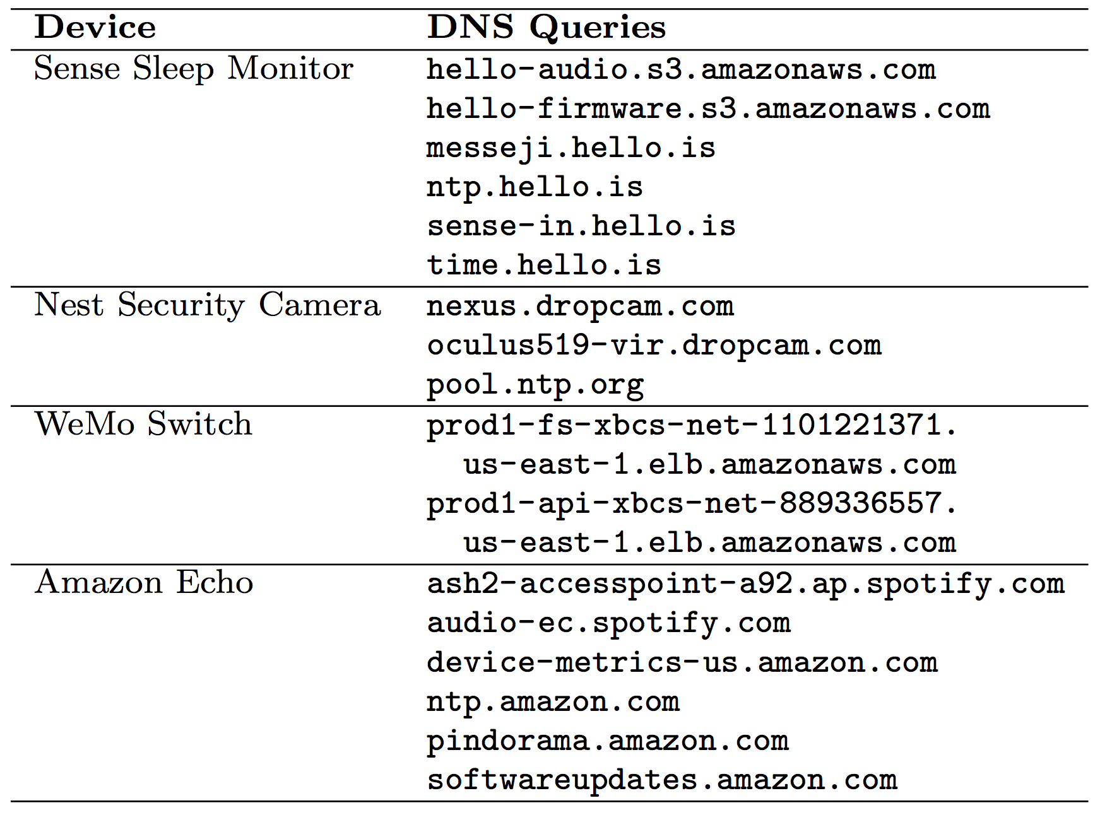
Analysis Strategy
Traffic on WAN side of Raspberry Pi NAT has same outgoing IP address
Use port number and incoming IP to separate packets into streams
Use DNS queries to label streams with device type
Examine send/receive rates of individual streams to reveal likely user behavior

Slide 11
Nest Cam Indoor Security Camera
=
Live streaming
Motion detecting
=
Notes:
Our first example is the Nest Security Camera
Specifically, we observed two distinct operational states of the camera: live streaming vs motion detection
In the live streaming state, the camera is actively recording its video feed and transmitting it to the cloud for live viewing on the Nest web or mobile application or to be saved for users with paid accounts
In the motion detecting state, the camera monitors the video feed locally rather than transmitting it live to the cloud. If it detects motion within the video, it takes a snapshot and sends a notification to the user
In this and the following slides, we plot send and receive rate in Bytes/second versus time since the start of traffic recording in seconds
For this particular instance, we recorded traffic while alternating the camera between the live streaming and motion detection states
We note that there is a clear distinction between camera’s network traffic rate between states.
This poses both a privacy and a physical security risk
A network observer should not be able to determine whether a security camera is being actively monitored

Slide 12
Nest Cam Indoor Security Camera
=
Motion event
*
*
*
*
*
*
*
*
Notes:
We then focused on the motion detection state
We recorded traffic while pointing the camera at a projection screen with a stationary shape located in one quandrant.
Every 2 minutes the shape was programmatically moved to a different randomly selected quadrant to simulate motion
These motion events caused the clearly distinguishable spikes in traffic from the Nest
This is a privacy risk because a network observer can observe the presence or absence of movement inside a user’s smarthome, potentially indicating whether
or not the user is at home

Slide 13
Sense Sleep Monitor
*
=
Went to bed
Temporarily
out of bed
Out of bed
in morning
=
**
***
=
*
**
***
Time
Notes:
For the next example, I set up the Sense sleep monitor in my house and recorded traffic over several days.
The sense sleep monitor has as a small clip with an accelerometer and gyroscope that you attach to your pillowcase, and a larger spherical hub that contains a microphone, thermometer, ligt sensor, and air quality sensor
This plot shows a representative 12 hour period with 3 particularly salient events
I went to bed at 12:30am, got out of bed temporarily at 6:30am, and got out of bed in the morning at 9:15am
Each of these activities corresponds with one of the three largest spikes in the network traffic rate from the Sense

Slide 14
WeMo Switch
*
=
Switch turned on/off
*
*
*
*
*
*
*
Notes:
Similarly, the WeMo smart switch also clearly evidences user interactions in it’s network traffic.
Whenever the user turns the switch on or off, either using the WeMo smartphone app or by pressing the physical button on the switch, there is a corresponding spike in traffic
This spike is necessary to keep the UI of the application updated as to whether the switch is on or off
Could allow a network observer to know whether a physical device in a user’s home is powered on or off.
If the identity of that device is determined through other methods, even more of a privacy concern

Slide 15
Amazon Echo
=
Question Asked
*
*
*
*
*
*
*
*
*
*
Notes:
Similar results with the Amazon Echo
Asked 3 different questions:
What is the weather?” “what time is it?” “what is the distance to Paris?

Slide 16
Takeaways
Encryption alone does not provide adequate privacy protection for smart home IoT devices
IoT devices’ limited-purpose nature makes traffic rate metadata even more privacy compromising than for traditional web browsing
Ongoing research indicates that strategic traffic injection will be necessary to provide probabilistic privacy guarantees
Notes:
Re-affirms the importance of metadata to privacy protection
Demonstrates that following what are considered to be best practices for device communications is not sufficient for user privacy protection
From a more academic perspective, this is an interesting example of a privacy risk specific to IoT devices that does not have a good counterpart in traditional web privacy for browsers
This vulnerabilities relies on the limited purpose of the devices.
For example, because the wemo switch only really has two states, there are only a few meaning attributable to changes in traffic patterns like the spikes we observed
So all of this begs the question, how to mitigate the risk.
We are currently exploring solutions that combine a VPN with selective traffic injection
If done properly, this would provide a probabilistic privacy guarantee
Some percentage of distinguishable changes in traffic state from actual user behavior and others from injected traffic
Reduces the adversaries confidence of inferences made based on traffic rate metadata
However, there could be other potential solutions, which I would be glad to talk about in the panel discussion

Slide 17
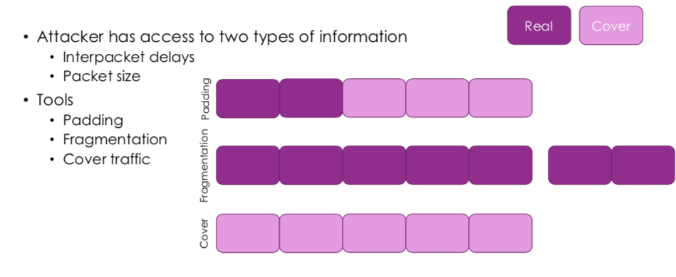
Defense: Traffic Shaping

Slide 18
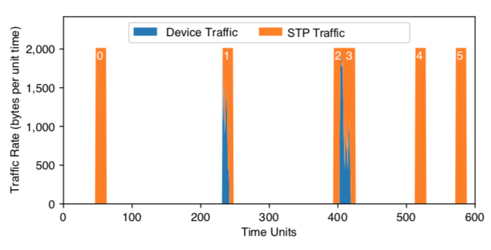
New Approach: Stochastic Traffic Padding
Traffic during use activities is shaped equivalently.
Additional periods of equivalent shaping are injected into traffic.

Slide 19
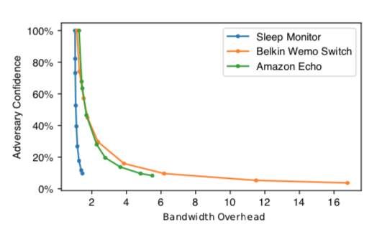
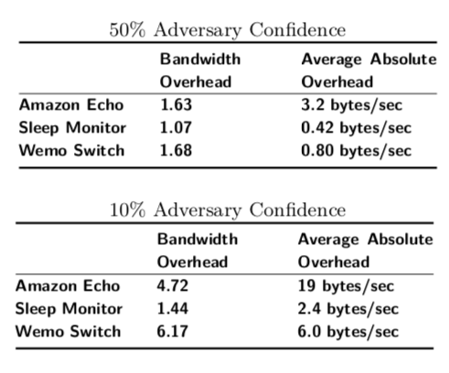
Bandwidth Overhead vs. Adversary Confidence

Slide 20
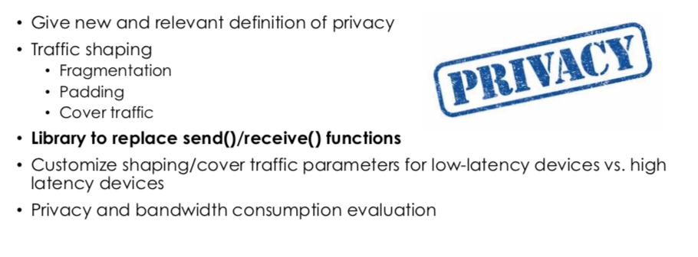
Operationalizing the Approach: Developer Library

Slide 21
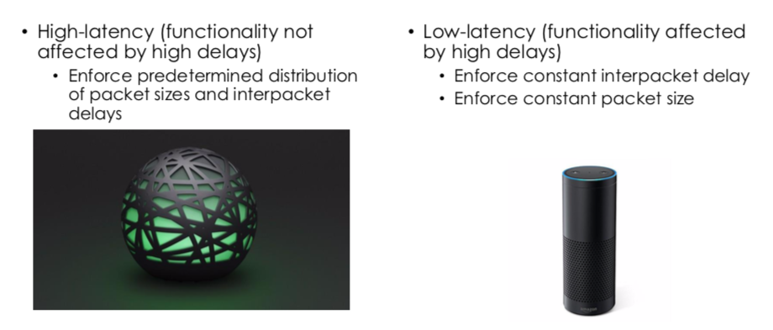
Coping with Different Latency Requirements

Slide 22
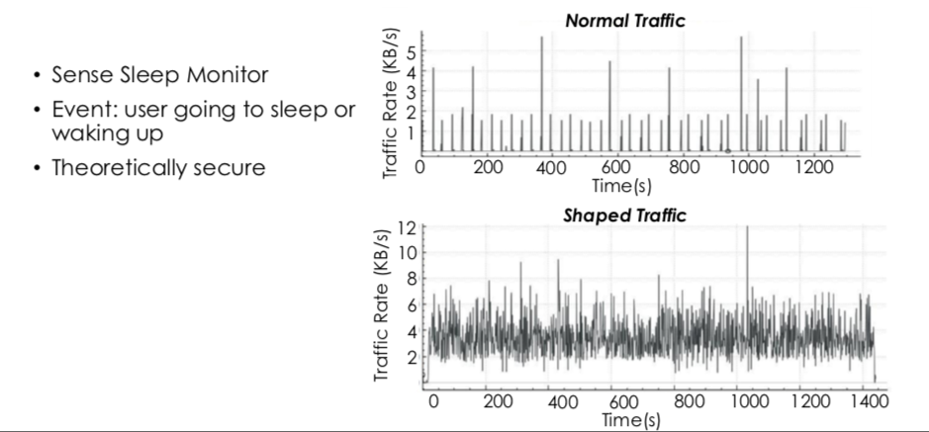
High-Latency Device: Results

Slide 23
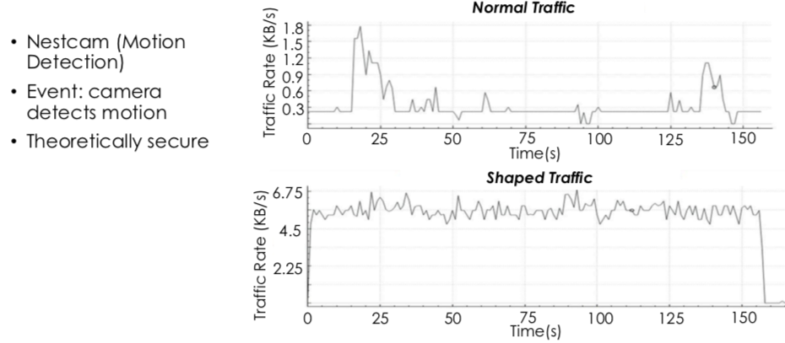
Low-Latency Device: Results

Slide 24
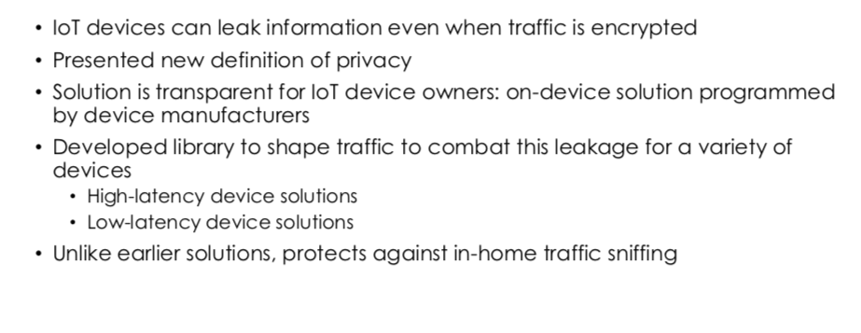
Summary: Activity Inference and Defenses

Slide 25
Giving Control Back to Consumers

Slide 26
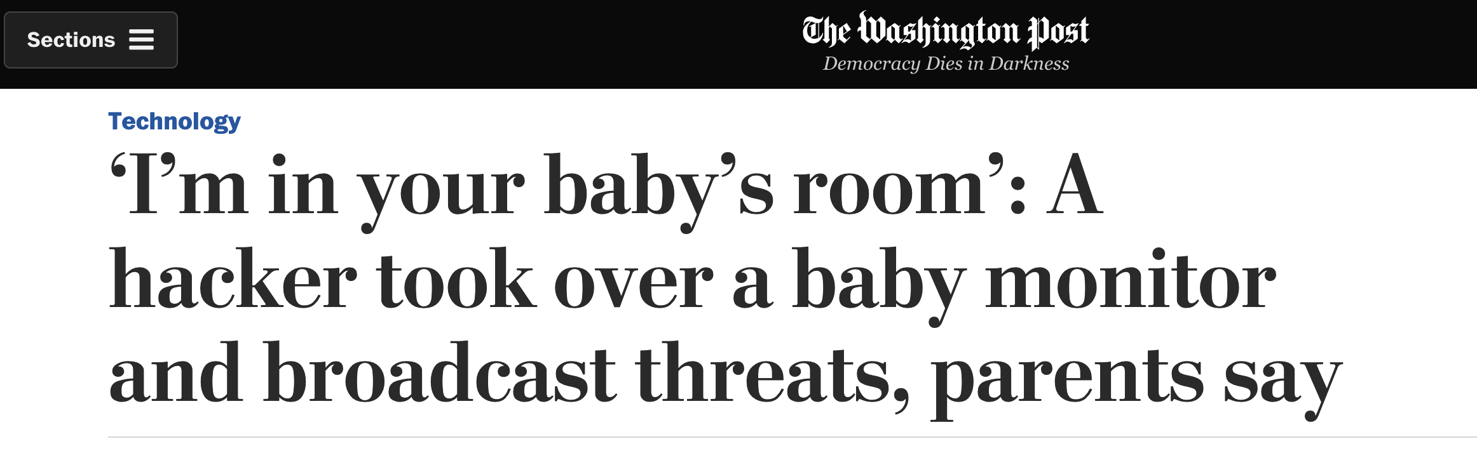

Goal: Systematic Study of Real Devices at Scale
Anecdotal reports
Large-scale studies
Internet exposed only
Home/enterprise networks: proprietary data

Slide 27
What is IoT Inspector ?
Open-source desktop application; passively monitors smart home networks
Benefits to IoT users
Easy to install and use
Visualization of potential security & privacy issues
Benefits to IoT researchers
Non-proprietary dataset
IoT traffic in real homes

Slide 28
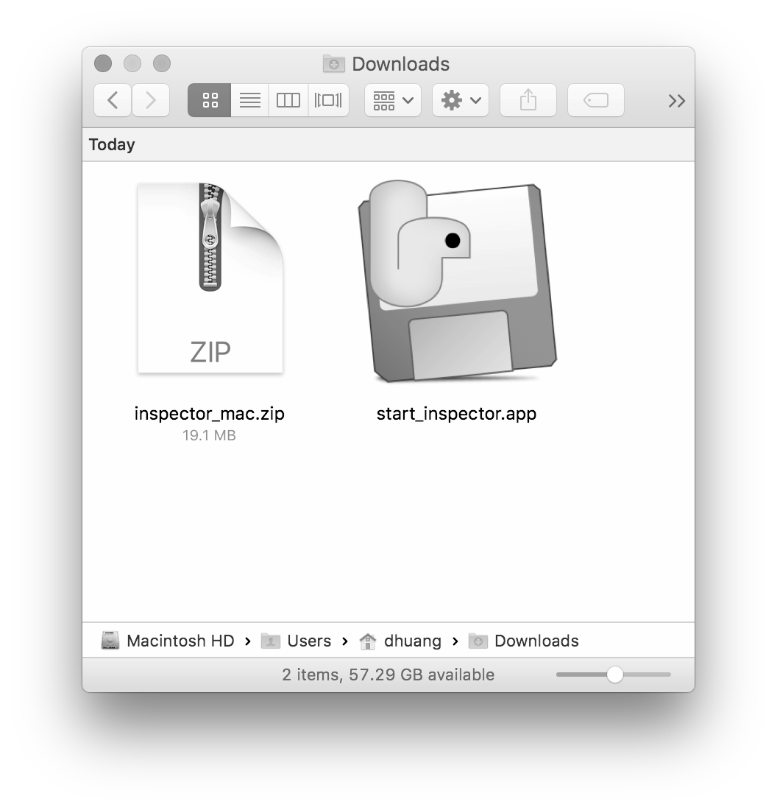
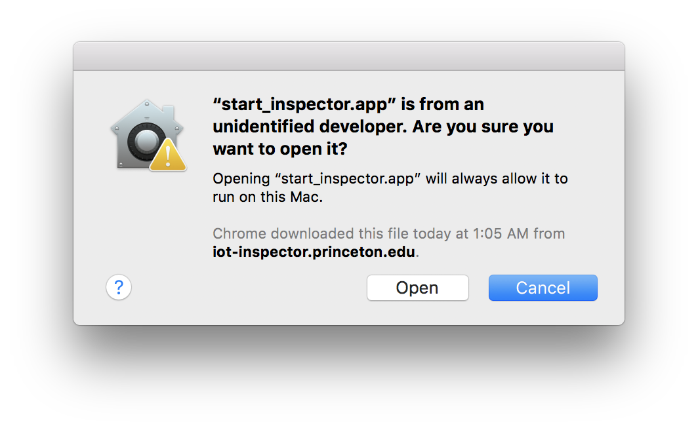
Download and Run IoT Inspector

Slide 29
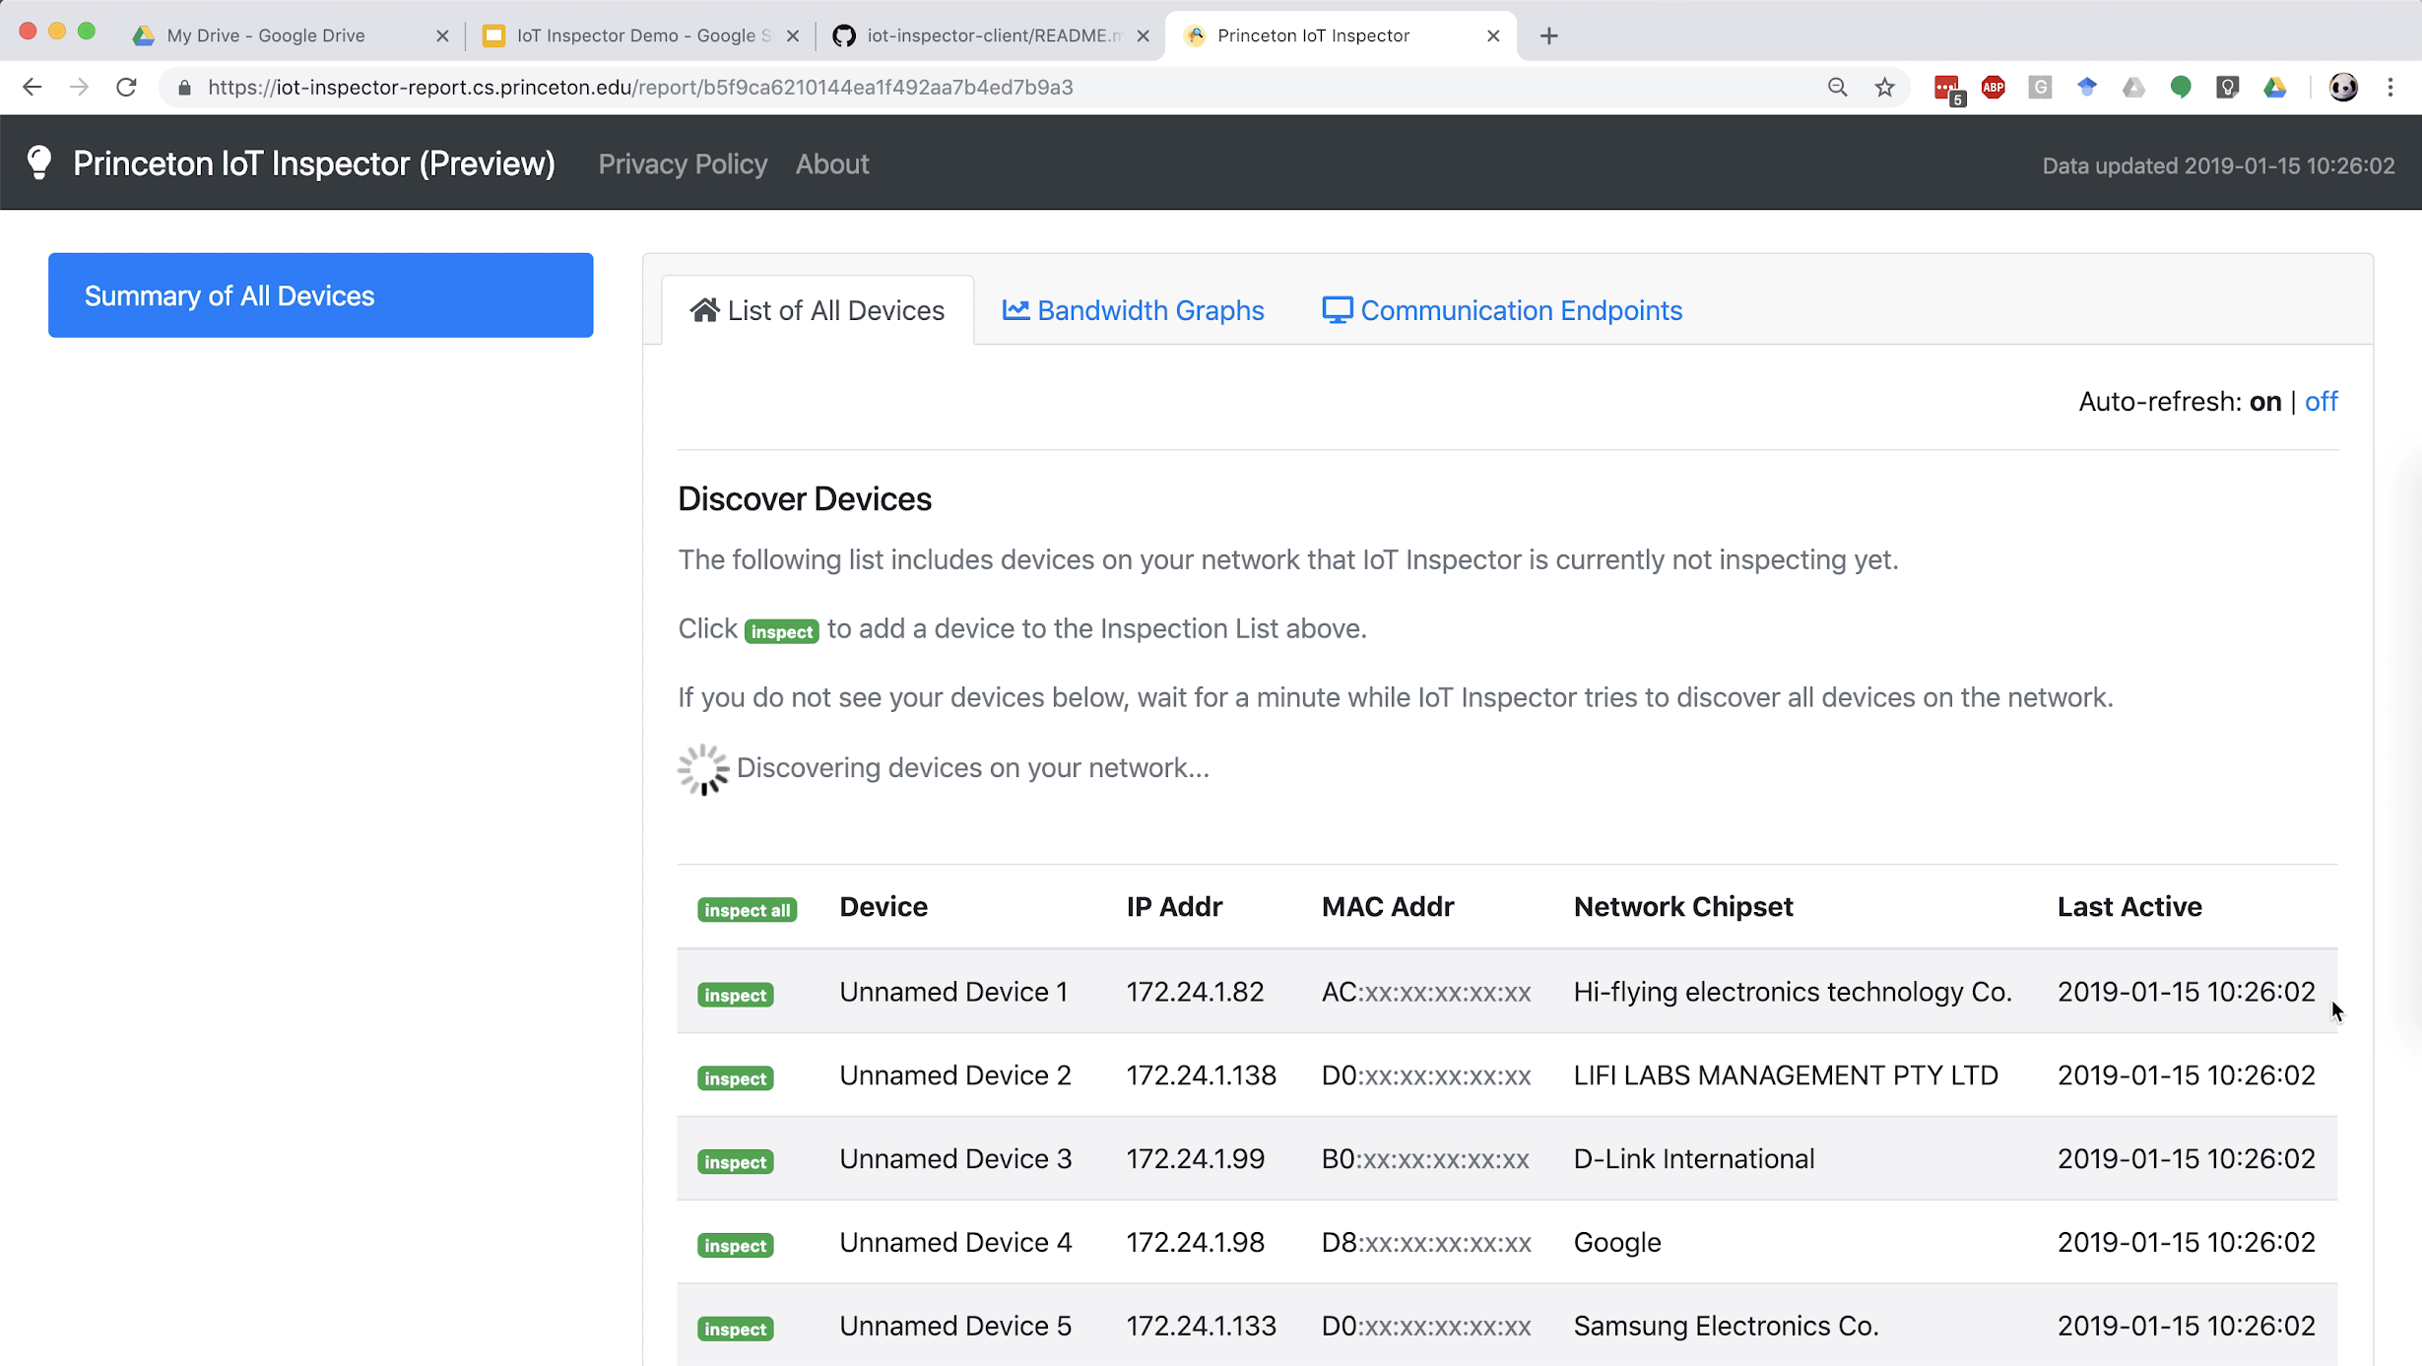
Download and Run IoT Inspector

Slide 30
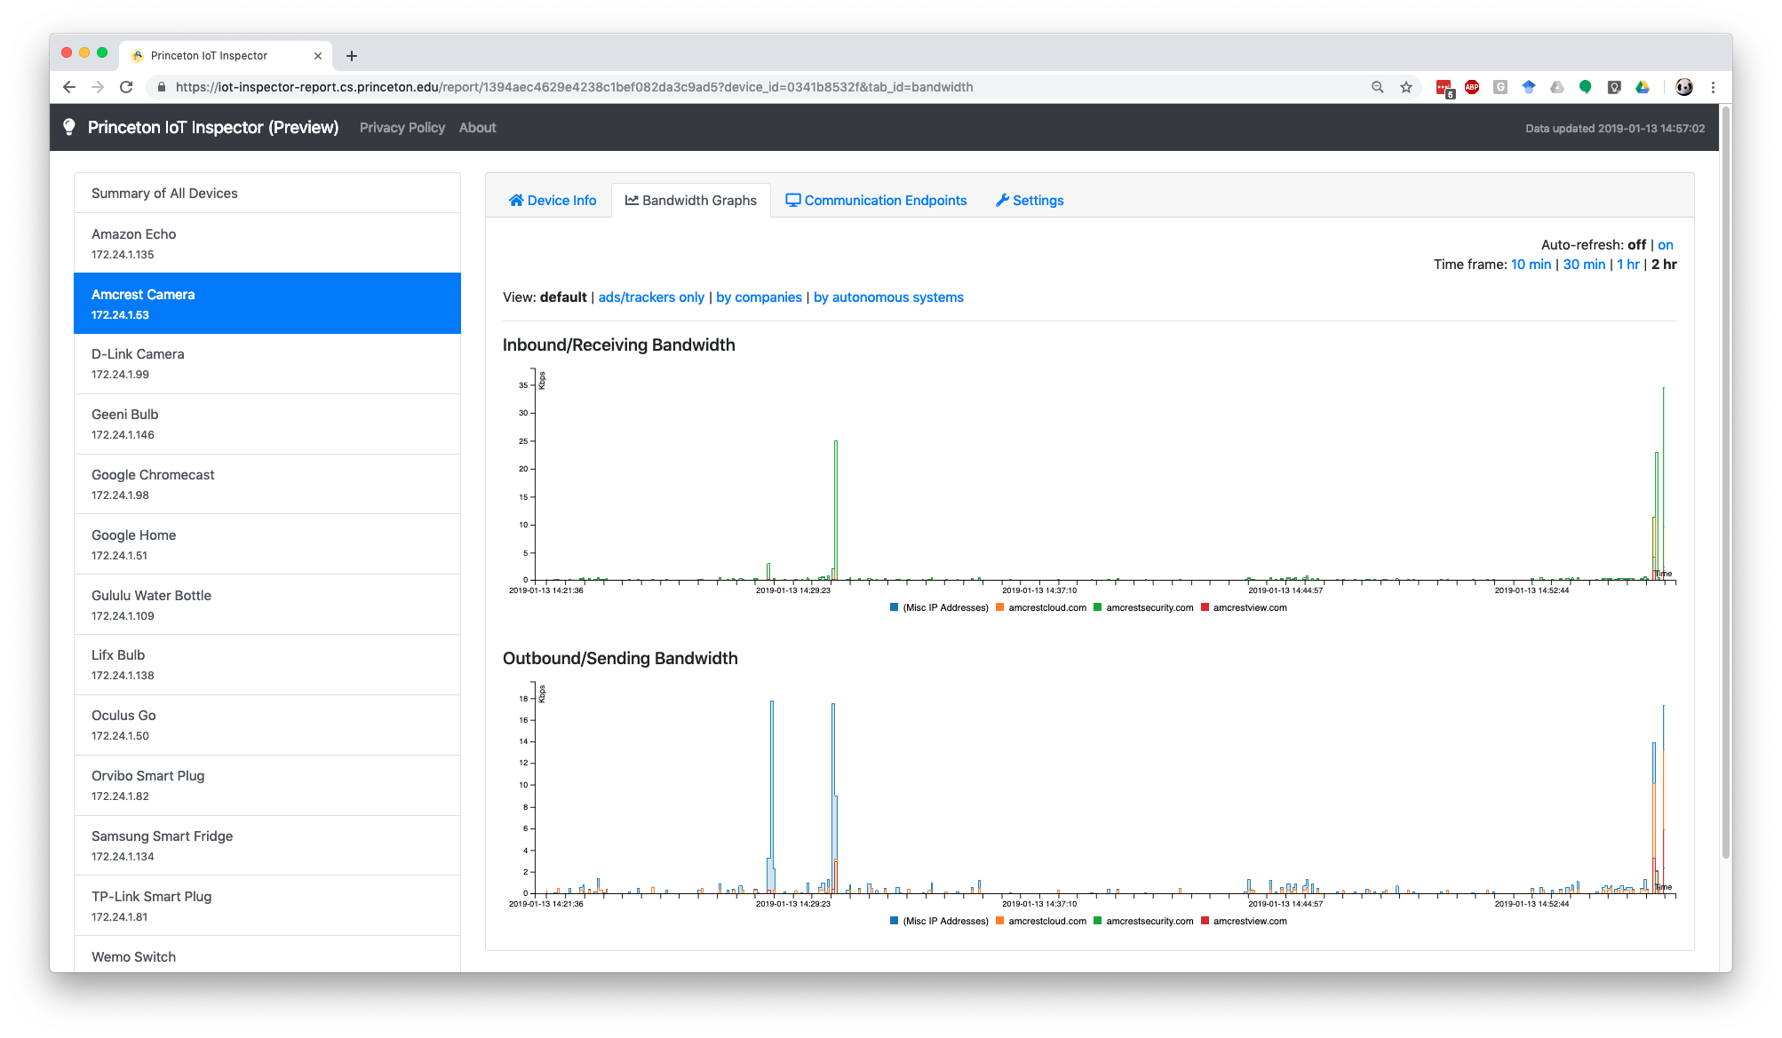
Bandwidth Graph for Each Device

Slide 31
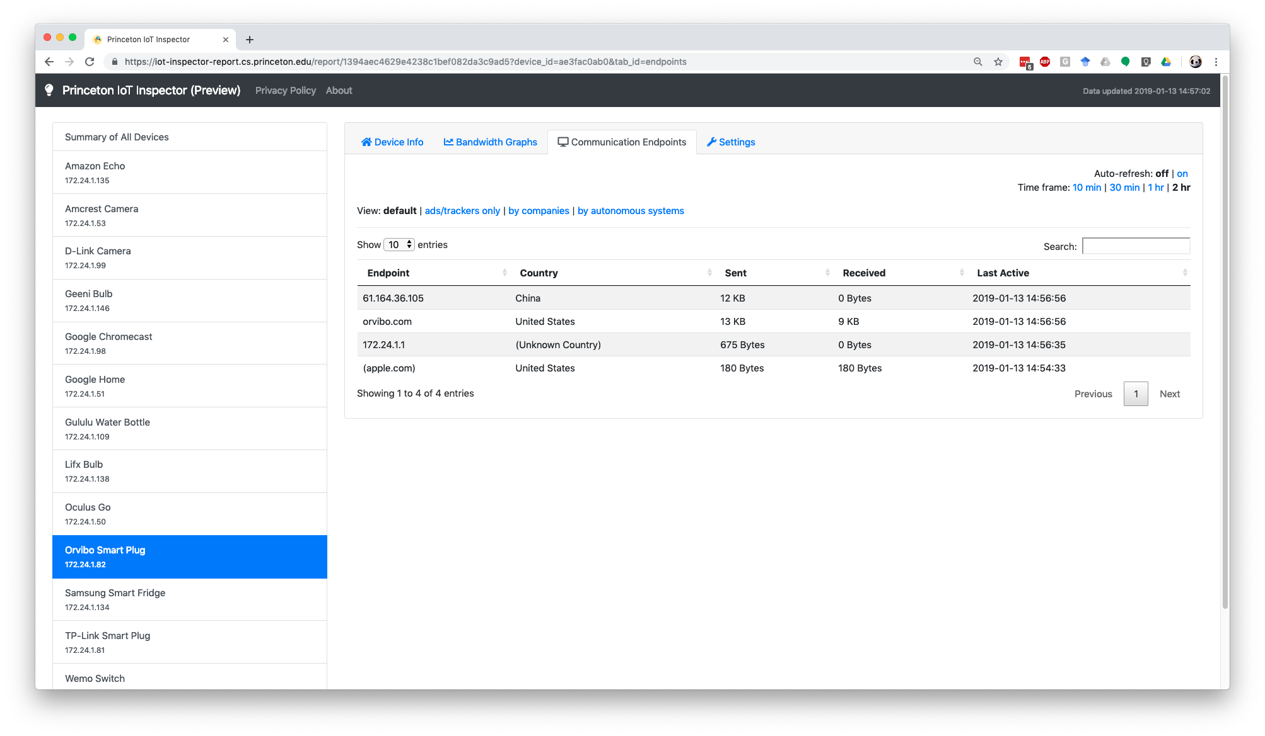
Bandwidth Graph for Each Device

Slide 32
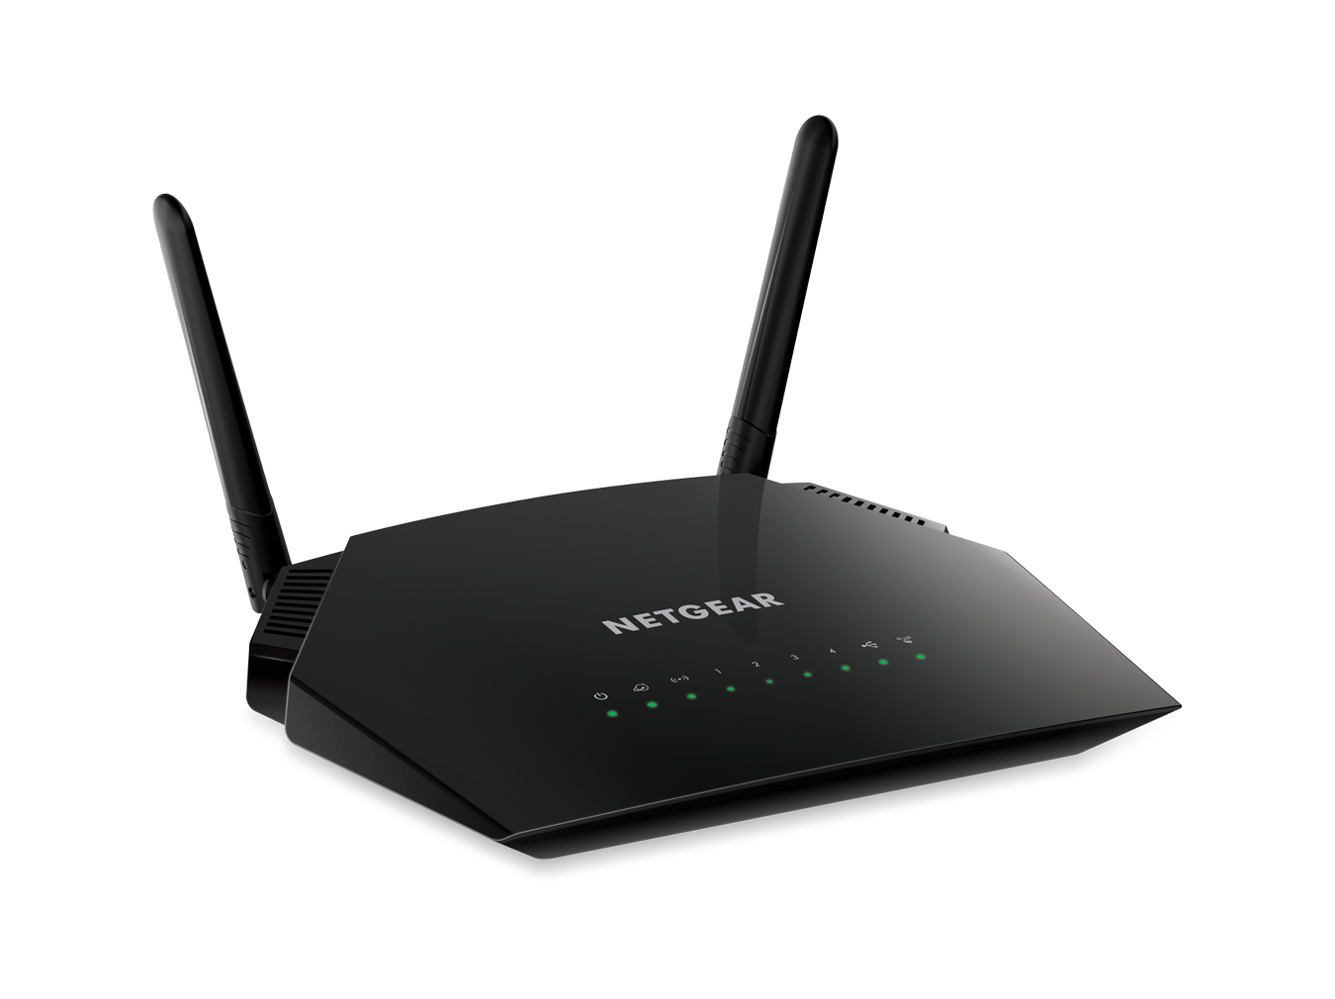
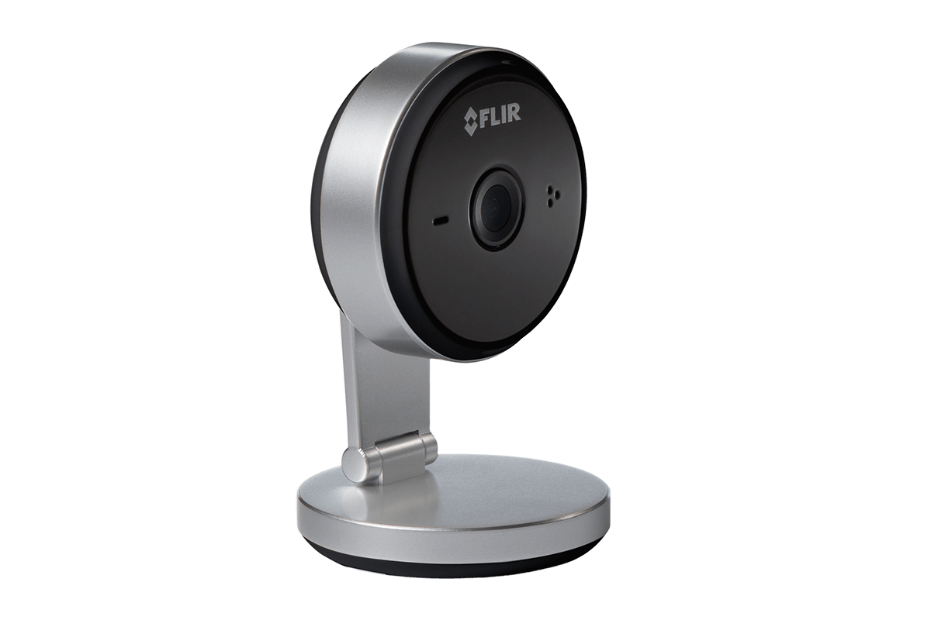

ARP Spoofing
Internet
Hi camera: I’m router!
Hi router: I’m camera!
IoT Inspector

Slide 33
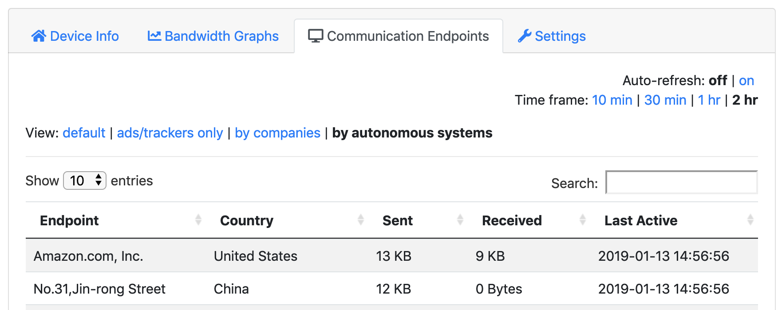
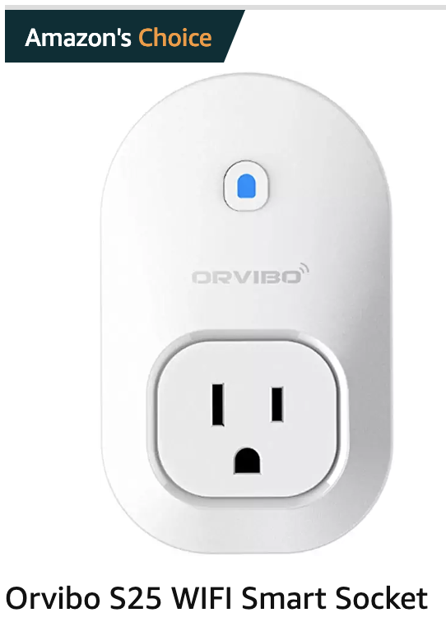
Who Devices Communicate With
Notes:
Again, first page on Amazon for “wifi smart socket”

Slide 34
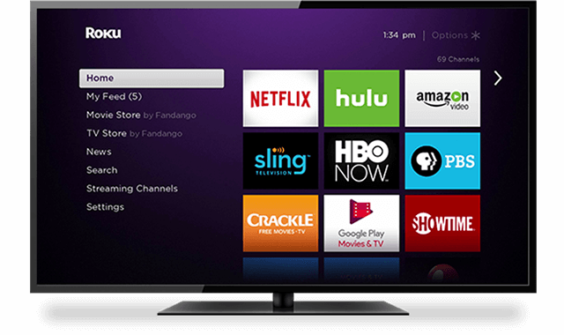

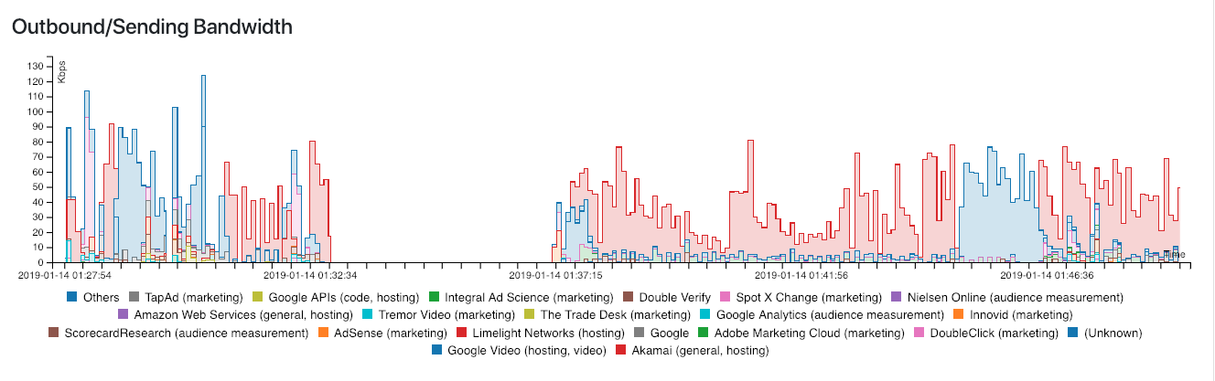
Ads and Trackers on Roku
Notes:
Roku: 30% of connected TVs; followed by 27% Amazon
https://iot-inspector-report.cs.princeton.edu/report/6aae51c55c2246721dac4b5b44743f2b

Slide 35

Ads and Trackers on Roku
Notes:
Roku: 30% of connected TVs; followed by 27% Amazon
https://iot-inspector-report.cs.princeton.edu/report/6aae51c55c2246721dac4b5b44743f2b

Slide 36
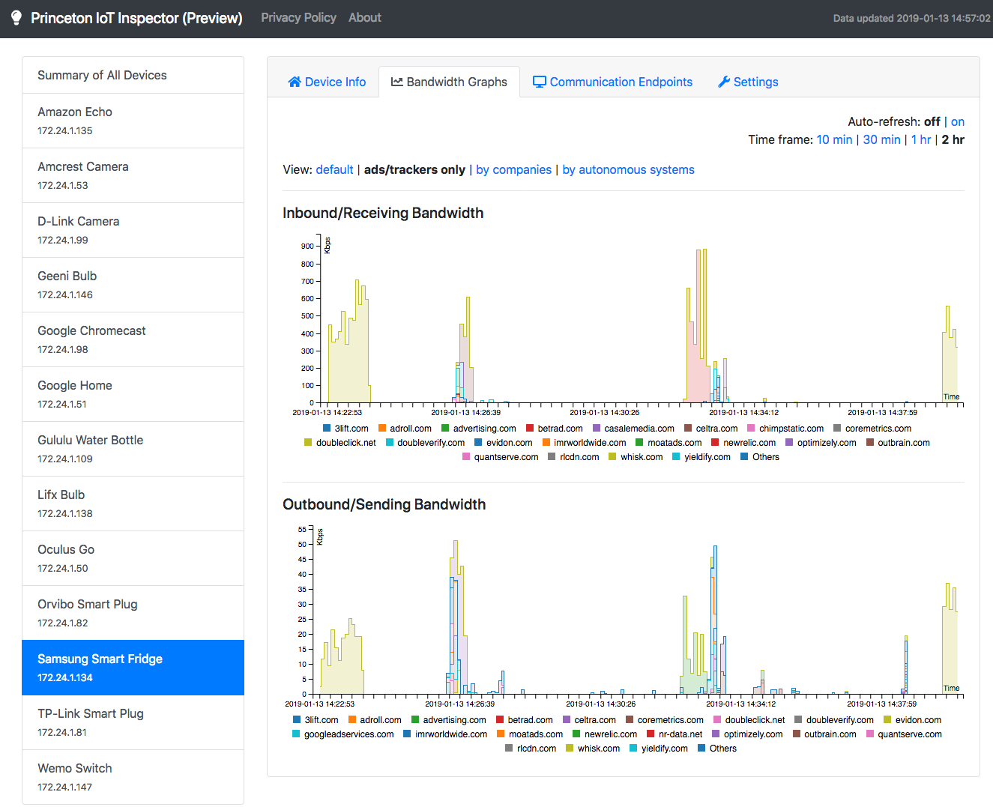
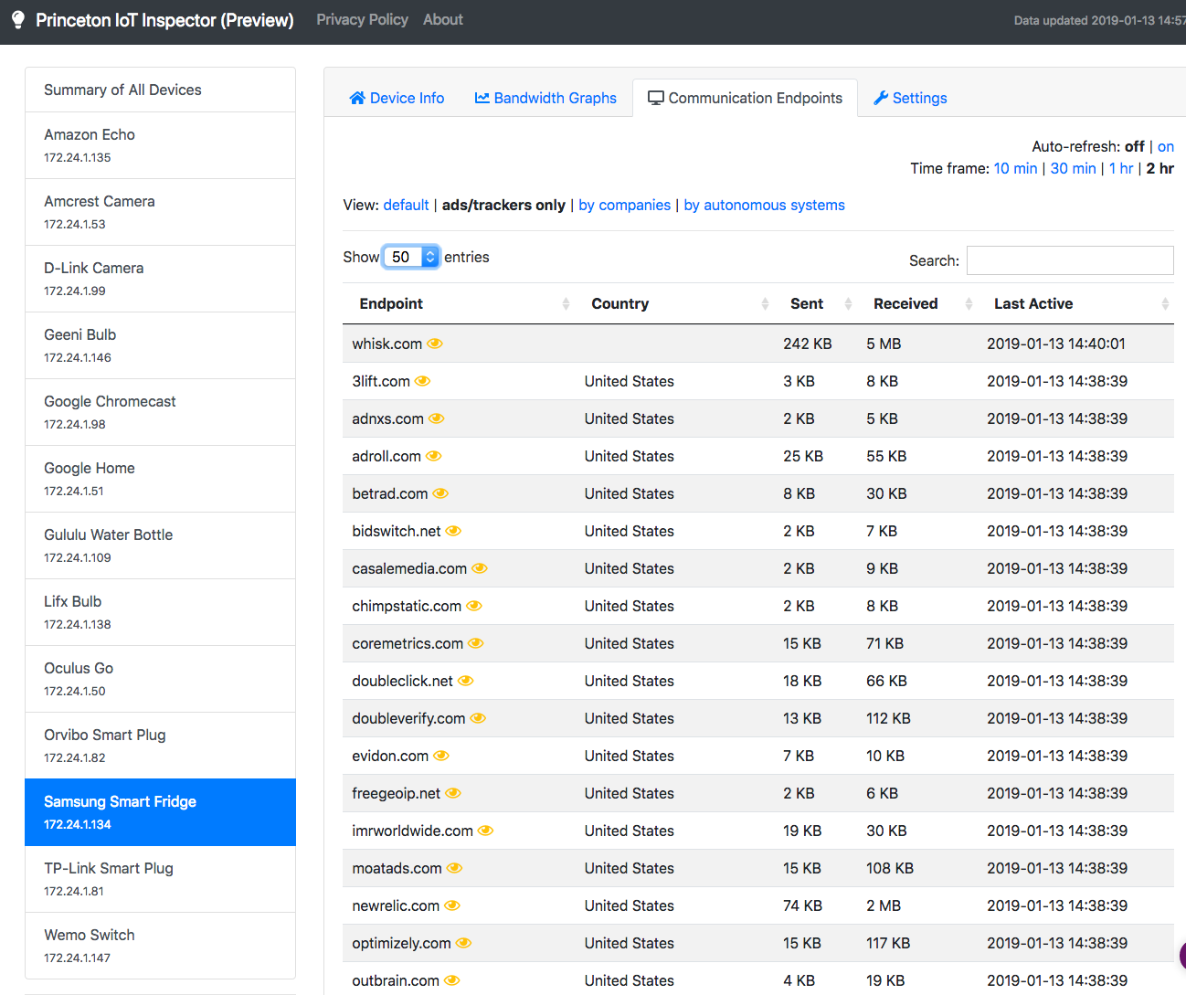
Notes:
Screenshots of your Samsung fridge, which actually talks to a whole bunch of trackers, including Nielsen!

Slide 37
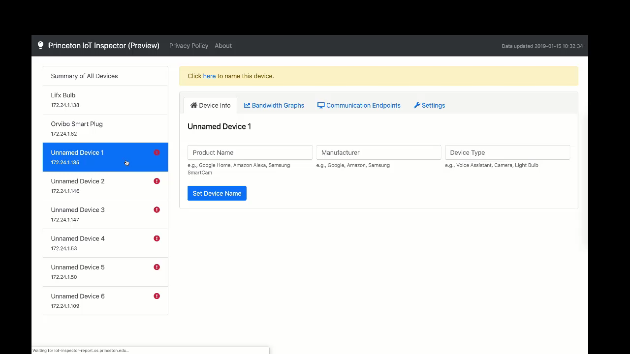

Slide 38
Deployment and Results to Date

Slide 39


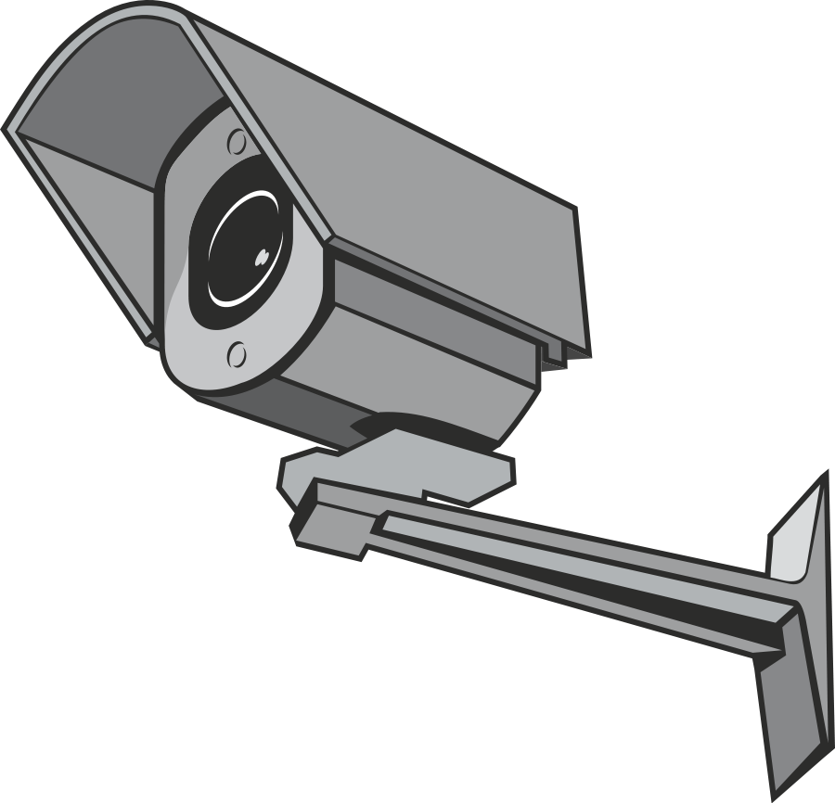
Summary of Insights
Privacy
Tracking/ads on TVs
Data aggregators on IoTs
Security
Anomaly detection
TLS (encryption) analysis, e.g.,
TLS 1.0: Samsung Smart Cam Amazon Prime Video on Roku
Insecure cipher suites: D-Link camera: 13 Amcrest Camera: 21

Slide 40
Security Risks: Web Attackers Can Control Your Home Devices

Slide 41
Attack 1:
Identify Local IoT Devices

Slide 42


Attack Steps
Get local IP (via WebRTC SDP)
192.168.6.6
Notes:
More relax

Slide 43
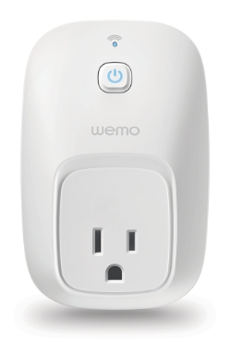
Attack Steps
2. Find active local devices.
Scan local subnet on port 81, sending GET request (via Fetch API)
Measure response times (TCP RST vs. TCP timeout)
192.168.6.88
192.168.6.6
Notes:
More relax

Slide 44
Attack Steps
2. Find active local devices.
Scan local subnet on port 81, sending GET request (via Fetch API)
Measure response times (TCP RST vs. TCP timeout)
192.168.6.88
TCP SYN to port 81
192.168.6.6
TCP RST
Notes:
TCP RST is fast!
Timeout is slooowww

Slide 45
Attack Steps
2. Find active local devices.
Scan local subnet on port 81, sending GET request (via Fetch API)
Measure response times (TCP RST vs. TCP timeout)
192.168.6.88
192.168.6.6
TCP SYN to port 81
192.168.6.89
?
Notes:
TCP RST is fast!
Timeout is slooowww

Slide 46
Attack Steps
3. Identify IoT devices.
Send request for our GET endpoints to active IP addresses, using HTML5 <audio> element.
Use resulting MediaError message to infer resource availability (new side channel).
192.168.6.88
192.168.6.6
Notes:
More relax

Slide 47
Attack Steps
3. Identify IoT devices.
Send request for our GET endpoints to active IP addresses, using HTML5 <audio> element.
Use resulting MediaError message to infer resource availability (new side channel).
192.168.6.88
192.168.6.6
GET /setup.xml
Notes:
More relax

Slide 48

Attack Steps
3. Identify IoT devices.
Send request for our GET endpoints to active IP addresses, using HTML5 <audio> element.
Use resulting MediaError message to infer resource availability (new side channel).
If Exists: MEDIA_ERR_SRC_NOT_SUPPORTED “DEMUXER_ERROR_COULD_NOT_OPEN: FFmpegDemuxer: open context failed”
Else: MEDIA_ELEMENT_ERROR “Format error”
Notes:
Not supposed to be possible for X-origin request due to SOP (except images/CCS and passive resources), this is a new vuln

Slide 49

Attack Steps
3. Identify IoT devices.
Send request for our GET endpoints to active IP addresses, using HTML5 <audio> element.
Use resulting MediaError message to infer resource availability (new side channel).
If Exists: MEDIA_ERR_SRC_NOT_SUPPORTED “Failed to init decoder”
Else: MEDIA_ELEMENT_ERROR “Message 404: Not Found”
Notes:
More relax

Slide 50


Attack Steps
3. Identify IoT devices.
Send request for our GET endpoints to active IP addresses, using HTML5 <audio> element.
Use resulting MediaError message to infer resource availability (new side channel).
Safari: Fetches timed out
Edge: No MediaError error messages
(Attack 1 does not work)
Notes:
More relax

Slide 51
Implications
Side-channel sidestepping SOP (Chrome bug bounty)
Attack stepping stone
Privacy leaks (e.g., network fingerprinting)
Notes:
More relax

Slide 52
Attack 2:
Access & Control Local Devices

Slide 53
DNS Rebinding
Attack fully bypassing SOP
(D. Dean, E. Felten, and D. Wallach, IEEE S&P 1996)
Requires a web attacker (controls malicious domain + webserver) also controlling domain’s authoritative DNS nameserver
Notes:
More relax

Slide 54
Attack Steps
192.168.6.88
Notes:
More relax

Slide 55


Attack Steps
Victim visits attacker.com, queries malicious nameserver for attacker.com. Return web server IP w/ short TTL.
Authoritative DNS Server
Attacker.com Web Server
6.6.6.6
GET / HTTP/1.1
ANSWER SECTION:
Attacker.com 1 IN A 6.6.6.6
192.168.6.88
HTTP 200
Notes:
More relax

Slide 56
Attack Steps
2. Attacker website loads another resource test.
Authoritative DNS Server
Attacker.com Web Server
6.6.6.6
192.168.6.88
Notes:
More relax

Slide 57
Attack Steps
3. If attacker.com’s DNS A record is cached, test is directly retrieved. If so, wait and retry...
Authoritative DNS Server
Attacker.com Web Server
6.6.6.6
GET /test HTTP/1.1
192.168.6.88
HTTP 200
Notes:
More relax

Slide 58
Attack Steps
4. If attacker.com’s DNS A record is not cached, browser queries malicious nameserver again. Now return target IP w/ large TTL.
Authoritative DNS Server
Attacker.com Web Server
6.6.6.6
ANSWER SECTION:
Attacker.com 300 IN A 192.168.6.88
192.168.6.88
Notes:
More relax

Slide 59
Attack Steps
5. This time, retrieving test fails. But attacker.com is now rebound to the target IP, and can make direct requests.
Authoritative DNS Server
Attacker.com Web Server
6.6.6.6
192.168.6.88
GET /test HTTP/1.1
HTTP 404
Notes:
More relax

Slide 60
Attack Steps
5. This time, retrieving test fails. But attacker.com is now rebound to the target IP, and can make direct requests.
Authoritative DNS Server
Attacker.com Web Server
6.6.6.6
192.168.6.88
GET /setup.xml HTTP/1.1
HTTP 200
Notes:
More relax

Slide 61
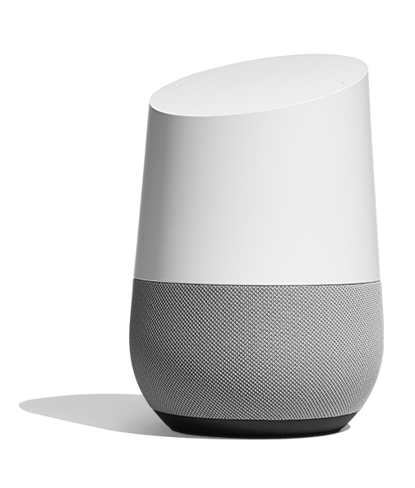
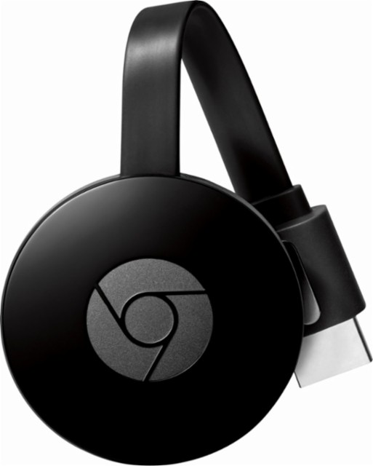
Attack on Devices
Google Home/Chromecast
Potential attacks:
Play arbitrary Youtube videos on Chromecast
Reboot Chromecast/Home
Scan for WiFi networks and return information
Notes:
More relax

Slide 62
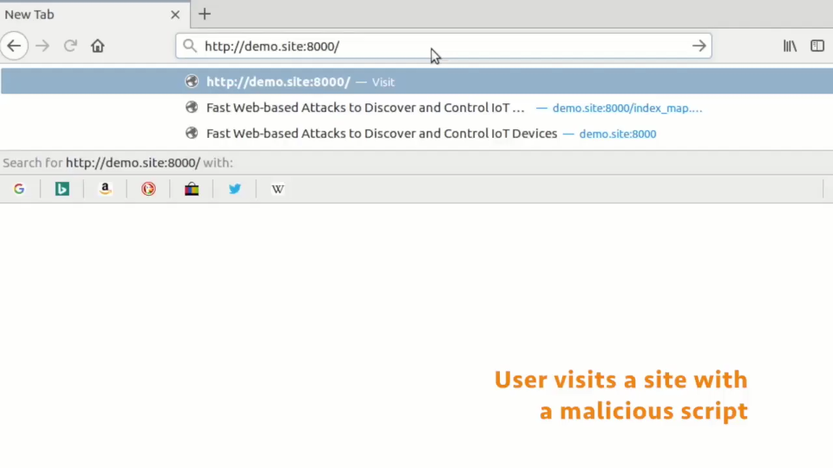
Fast Web-based Attacks to Discover and Control IoT Devices Gunes Acar, Danny Y. Huang, Frank Li, Arvind Narayanan, and Nick Feamster. ACM SIGCOMM Workshop on IoT Security and Privacy. 2018.
Notes:
Many of these devices interface with their smartphone app companion through a (simple, insecure, unauthenticated) web server.
This means that…
Classical web-based attacks also work on many of these devices!

Slide 63
Implications
Attacker control of IoT device actions
Exploiting IoT device vulnerabilities for full compromise
Privacy leaks (e.g., extensive device fingerprinting or user profiling)
Notes:
More relax

Slide 64
Moving Forward...
Low barrier to attacks on local IoT devices via malicious websites.
Need defenses that protect against lateral attacks.

Slide 65
Conclusion
Security challenges in smart homes due to lack of isolation of devices from one another
Web-based discovery and control
Privacy challenges due to pervasive tracking, lack of encryption
IoT Inspector (https://iot-inspector.princeton.edu/)
More information: feamster@uchicago.edu

